Slide 1

RATIO ANALYSIS AND BREAKEVEN ANALYSIS.

Slide 2
RATIO ANALYSIS
Definition
The ratio is the quantitative relation between two amounts showing the number of times one value contains or is contained within the other.
Ratio analysis is the process of determining and making an interpretation of numerical relationships based on financial statements
  These relationships can be expressed as a percent or as a quotient
Persons interested in financial statements:
Owners or investors - estimating earning capacity
Creditors of a firm - concerned with liquidity and loan redemption within a specified period.
Financial executives – concerned with analysis which help in making intelligent decisions.

Slide 3
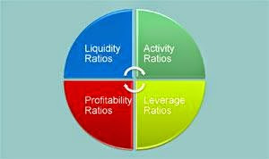
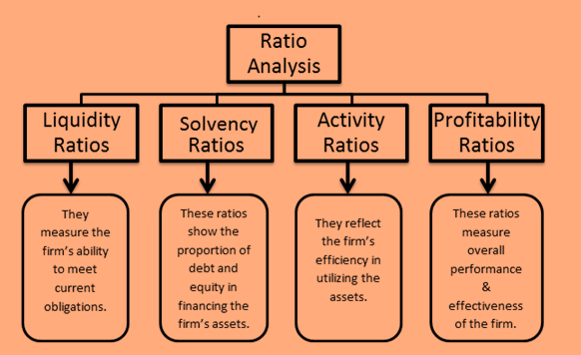
Classification of financial ratios on the basis of function:

Slide 4
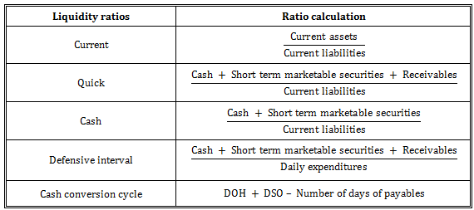
1. Liquidity ratios
They measure the adequacy of current liquid assets and help in evaluating the ability of the business to meet its short-term debts.
A company with sufficient current and liquid assets to pay off its current liabilities has a strong liquidity
The adverse effect of liquidity ratios:
They only tell us about the quantity and nothing about the quality of current assets.

Slide 5
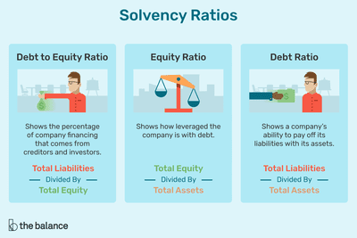
They are also called long- term solvency ratios
They measure and indicate the ability of a firm to survive for a long period of time.
They help stockholders and creditors in an indication of going concern of the company
Other examples of solvency ratios:
Debt to equity ratio
Proprietary ratio
Fixed assets to equity ratios
Capital gearing ratio
A current asset to equity ratio
Times interest ratio.

Slide 6
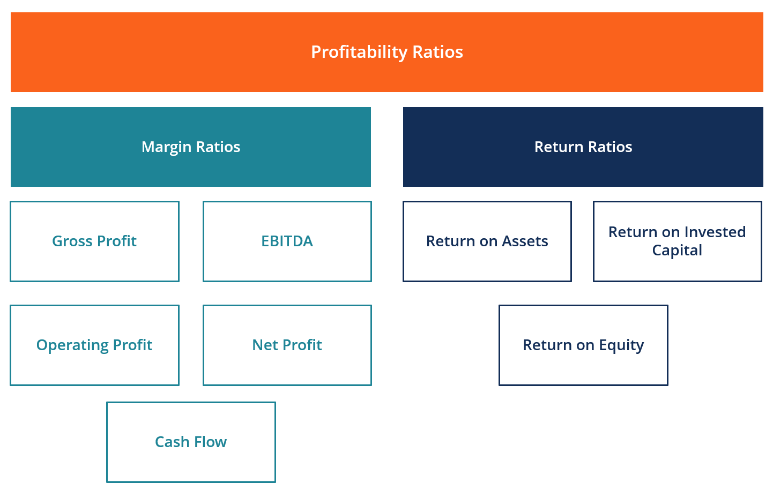
3. Profitability ratios
These ratios measure the efficiency of management of an organization to utilize available resources and generate profits.
Strong profitability position ensures higher income to common stockholders and efficiency in operations.

Slide 7
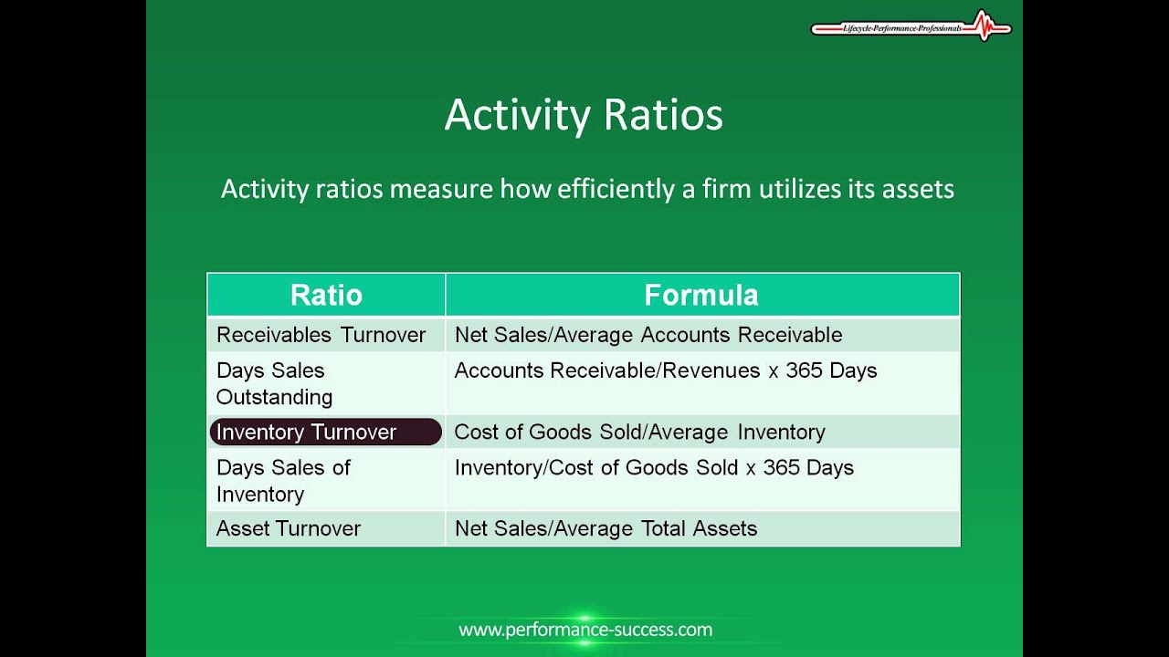
4. Activity / turnover ratios:
They measure the efficiency of the firm in generating revenues through the conversion of its production into cash or sales.
Generally, the fast conversion is highly preferred as it increases revenues and profits
Frequently used in conjunction with liquidity ratios in-depth analysis.
Inventory turnover ratio,
Average collection period,
Receivables turnover ratio,
Accounts payable ratio,
Fixed asset turnover ratio,
Working capital turnover ratio,
Average payment ratio,
Working capital turnover ratio.

Slide 8

BREAK EVEN ANALYSIS
This is the point at which neither profit nor loss is being made by a firm.
Break even formula:
B.E.P =$\frac{Fixed costs}{contribuition per unit}$
Breakeven analysis is based on categorizing production costs to those which are variables and fixed.
Variable costs -these are costs which change when the production output changes.
Examples:
Material costs
Direct labour attributed to the production
Commissions
Machine labour costs
Fixed costs- these are costs not directly related to the volume of production.
Examples:
Administration costs
Depreciation costs
Rent and rates
Research and development

Slide 9
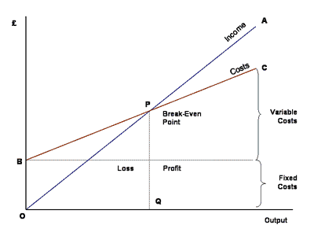
Break-even chart analysis

